Slide 1
Chrome OS for Mac Device

Slide 2
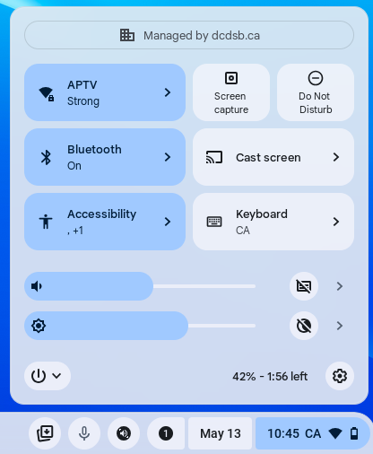
Settings Menu
The settings menu can be opened by tapping the time -(bottom right corner)
In this menu you can control and customize various settings in your device including Wi-fi, audio, language, and accessibility features.

Slide 3
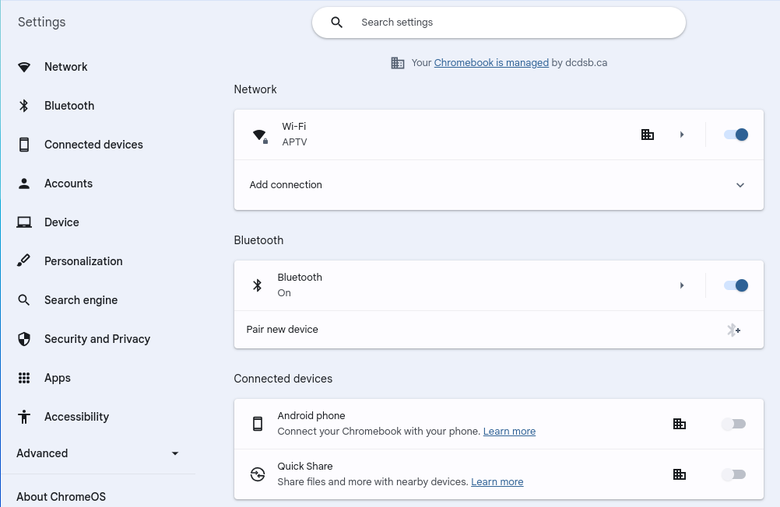
Full View Settings Menu

Slide 4
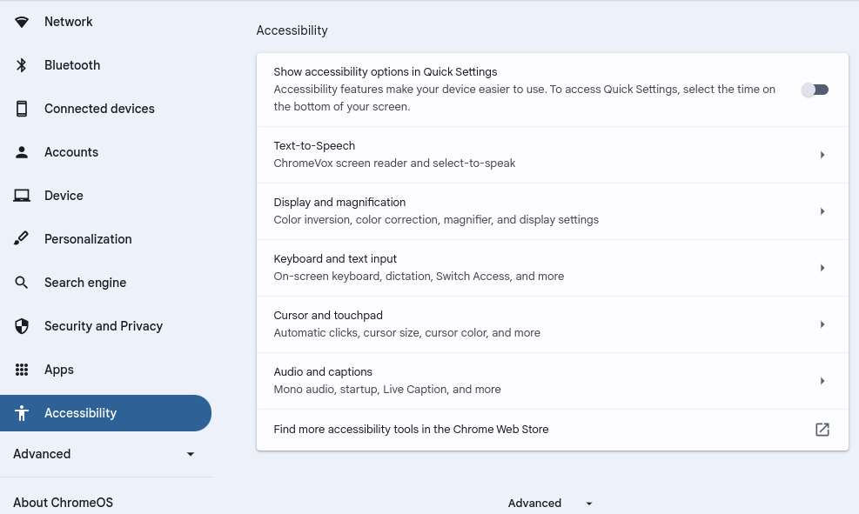
Accessibility Menu Full View
Notes:
Text-to-speech: Toggle ON -Select-to-Speak
Keyboard text and input: Toggle On -Dictation

Slide 5
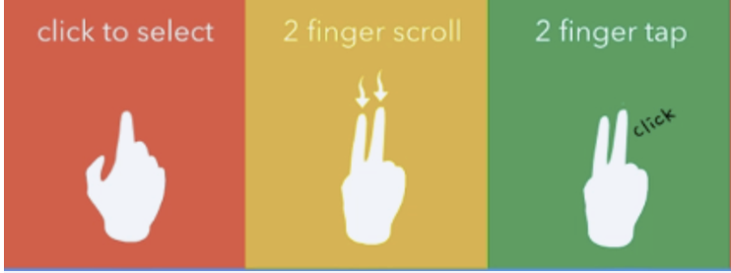
Trackpad Gestures
Image above shows the 3 ways trackpad gestures work
Click or tap to select
2 finger scroll (up or down)
2 finger tap (Functions as Right Click)

Slide 6
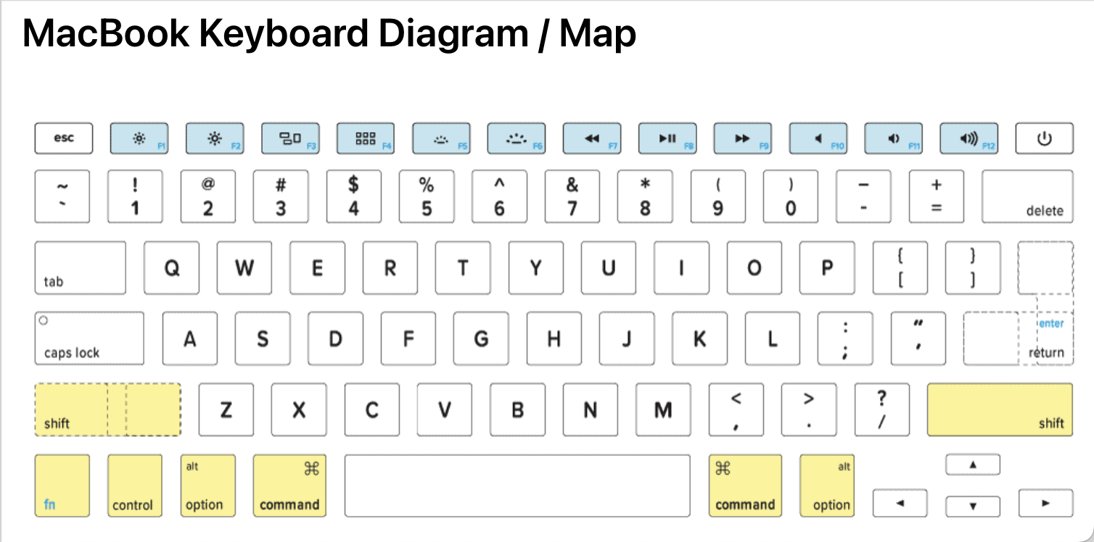
MacBook Keyboard Visual
Notes:
Command = Control
Control = ALT
Delete = Backspace

Slide 7
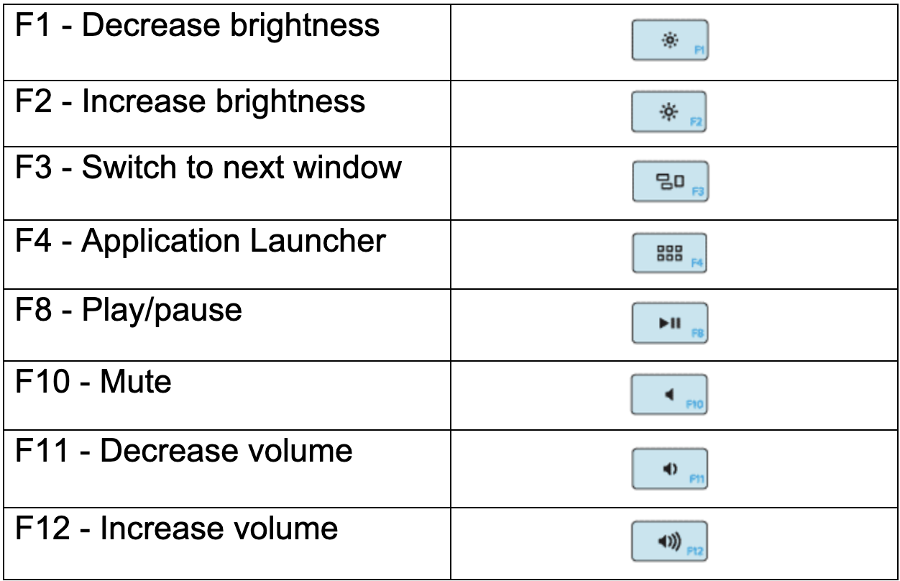
Function Keys

Slide 8


Launcher
Your launcher is where you can find all of the APPs on your computer.
Engage your Launcher by pressing F4 or the Control button

Slide 9
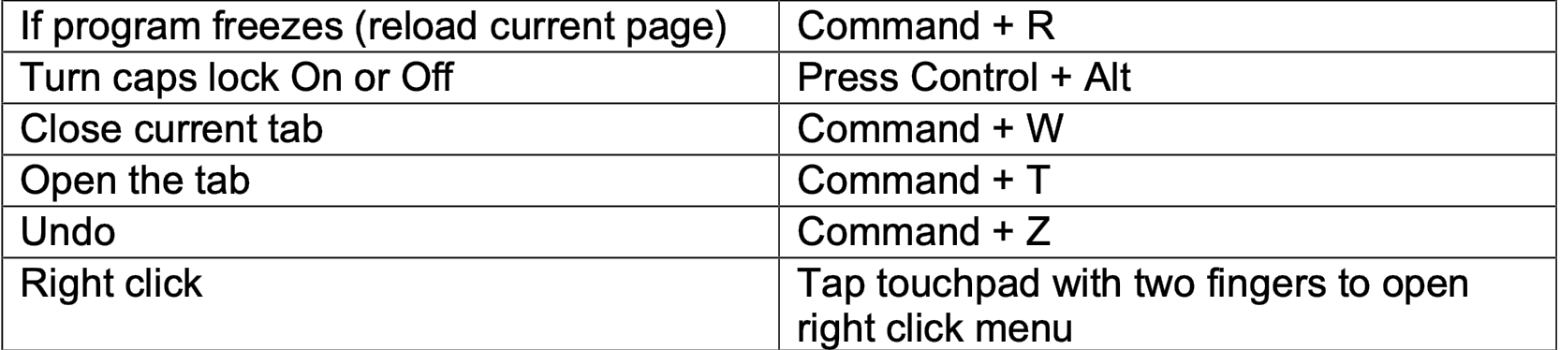
Trouble Shooting

Slide 10
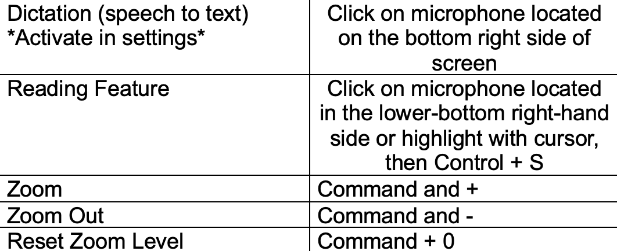
Accessibility Hotkeys

Slide 11

Spilt Screen Hotkeys

Slide 12
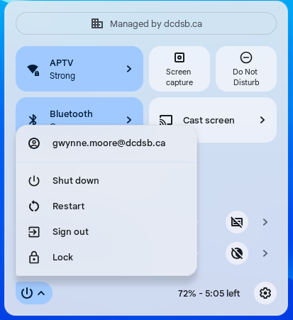
To Properly Shutdown the Computer

Slide 13
Further Information & Resources
Assistive Technology Team
Lead: Teresa Ezquerra
Specialist: Kristi Norris
Specialist: Jenn Baal
Specialist: Joanna Armstrong
PowerPoint created by: Gwynne Moore

